Slide 1
Publix Super Markets
"Begin. The rest is easy." -George Jenkins
How Publix is integrating automation into the retail edge
Gary Palmer, Tony Lobozzo, Nick Johnston
Session type: Breakout session
Wednesday, May 13 10:30 AM - 11:10 AM EDT
B312-B313 - Level 3
Notes:
Tony: George W. Jenkins, A.K.A. Mr. George, founder of Publix Super Markets, had a small sign on his desk that read “Begin. The rest is easy”. This was more than a motivational phrase — it was a deliberate leadership practice designed to remove barriers to communication and action.
Core meaning: The phrase encourages people to start talking, starting working, or starting a process without overthinking or waiting for perfect conditions. Mr. George knew that when others came to him with problems or ideas, they might feel intimidated by meeting the head of a company. The sign was a visual reminder that you don’t need to be perfect or fully prepared before you begin — just start, and the rest will follow

Slide 2
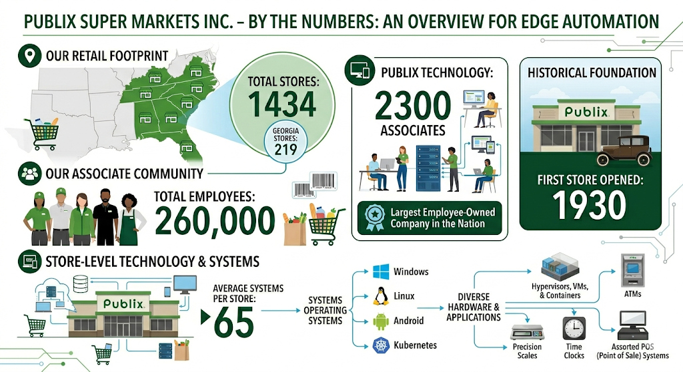
About Publix
Notes:
[Publix Numbers]
How many stores? 1434 (219 here in GA)
How Many Employees? 260,000
How Many in Publix Technology? 2300
Employee Owned? largest employee-owned company in the nation
[Technology]
How many systems per store? 65
Different types of systems? (Windows, Linux, Android, Kubernetes) - varying from hypervisors, vms, and containers to ATMs, scales, time clocks, and an assortment of POS systems
This works out to ~ 90K systems in retail.
https://corporate.publix.com/about-publix/company-overview/facts-figures

Slide 3




Retail Modernization
Modernization
Reduce manual effort in Retail by introducing:
Automation
First
DevOps
Patterns
Modern Artifact
Management
Infrastructure as code
Faster execution - improved accuracy, reliability, and consistency
Notes:
Modernization had been success in the datacenter and corporate, we wanted to extend this to the store.
Enabling cloud native possibilities is the reason for the Retail modernization effort at Publix.
Reduced manual effort
Automation first thinking
DevOps Patterns
Modern artifact management
As code approach
Faster execution
Improved accuracy, consistency, and reliability
Kubernetes, containers, and microservices at the store was the answer, but how are we going to bootstrap, automate and orchestrate that?
In a way that aligned with modernization

Slide 4
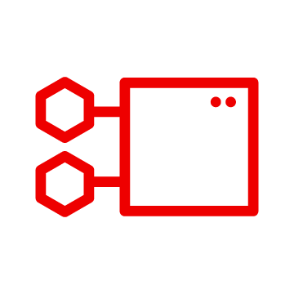
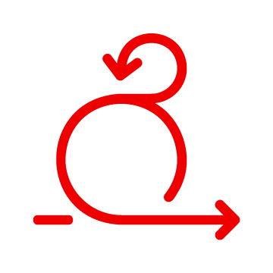

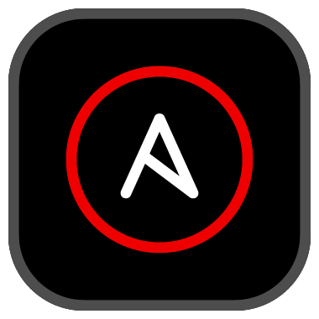
Retail Modernization Automation
2021 - 2022
2023 - 2024
2025- 2026
>
>
Kubernetes
Software Delivery
Operations
Forced to rethink automation at edge
Existing model couldn’t get us there ​
We leaned on data center​ success
Proved in the lab with full automation
Pilot in store (k8s only) ​
Pilot deployments in stores
Mass single-node Kubernetes
Opportunity to align app deployments
POS, RSLP/NewStore
Begin-3-node Kubernetes
Help Desk, RSU
Notes:
Why retail forced us to change (≈ 2 minutes)
Deployments were still largely manual, click-driven, and procedural. They weren’t code-first, they weren’t API-driven.
Most importantly — they were slow.”
“And as the business accelerated, that gap just kept widening. Retail doesn’t slow down so IT can catch up.”
“When we introduced Linux and Kubernetes into the stores, it forced us to rethink how. Our existing retail automation model simply couldn’t support that kind of platform at the edge.”
How the platform evolved at the edge (≈ 2–3 minutes)
“We didn’t start by boiling the ocean. We leaned on what already worked for us in the data center and adapted it for retail.”
“We fully automated everything in the lab first. Then we took it into pilot stores and validated it under real conditions — bad networks, limited hardware, and real operational pressure.”
“That’s where Ansible became critical. We used it to deploy K3s Kubernetes clusters directly into the stores, treating each store as a small, autonomous platform.”
“Over time, that matured — from mass single-node clusters to three-node clusters as hardware cycles caught up. That evolution took years, not months. But automation made it repeatable and survivable.”
(handing off ??): “And once the platform stabilized… that’s where things really changed.”
What changed when apps could finally move fast (≈ 2–3 minutes)
“That stable platform created opportunity.”
“Application teams weren’t bound to vendor release cycles or manual deployment gates. We could evaluate modern application delivery in a way that matched how the business wanted to move.”
“We leaned into self-service automation. Using Ansible playbooks and shared automation resources, application teams could own how their software moved into stores — safely, consistently, and at their pace.”
“App teams moved faster. Platform teams added new capabilities without breaking consumers. And the business stopped waiting on release windows.”
“Five years in, this isn’t just a modernization project — this is how we are operating.”
“Automation is what lets platform and applications evolve independently — without losing reliability, control, or scale.”
Gary – Started by deploying K3s clusters to the stores using Ansible.
Tony – Opportunity! Started working with app teams internally developing the core Retail applications evaluating modern deployment possibilities that were no longer dependent on vendor release timelines.
Agility creating a space for rapid software development driving the need for platforms to keep up!
Enabled and really impowered and application teams by providing a self-service release mechanism leveraging playbooks and ansible resources that they develop and own.
Provides space for engineering teams that own the platform to introduce new capabilities and features for application teams to consume
Retail Support Utility – custom frontend integrated with Ansible to providing a centralized interface for operational users to support the Retail environment.

Slide 5
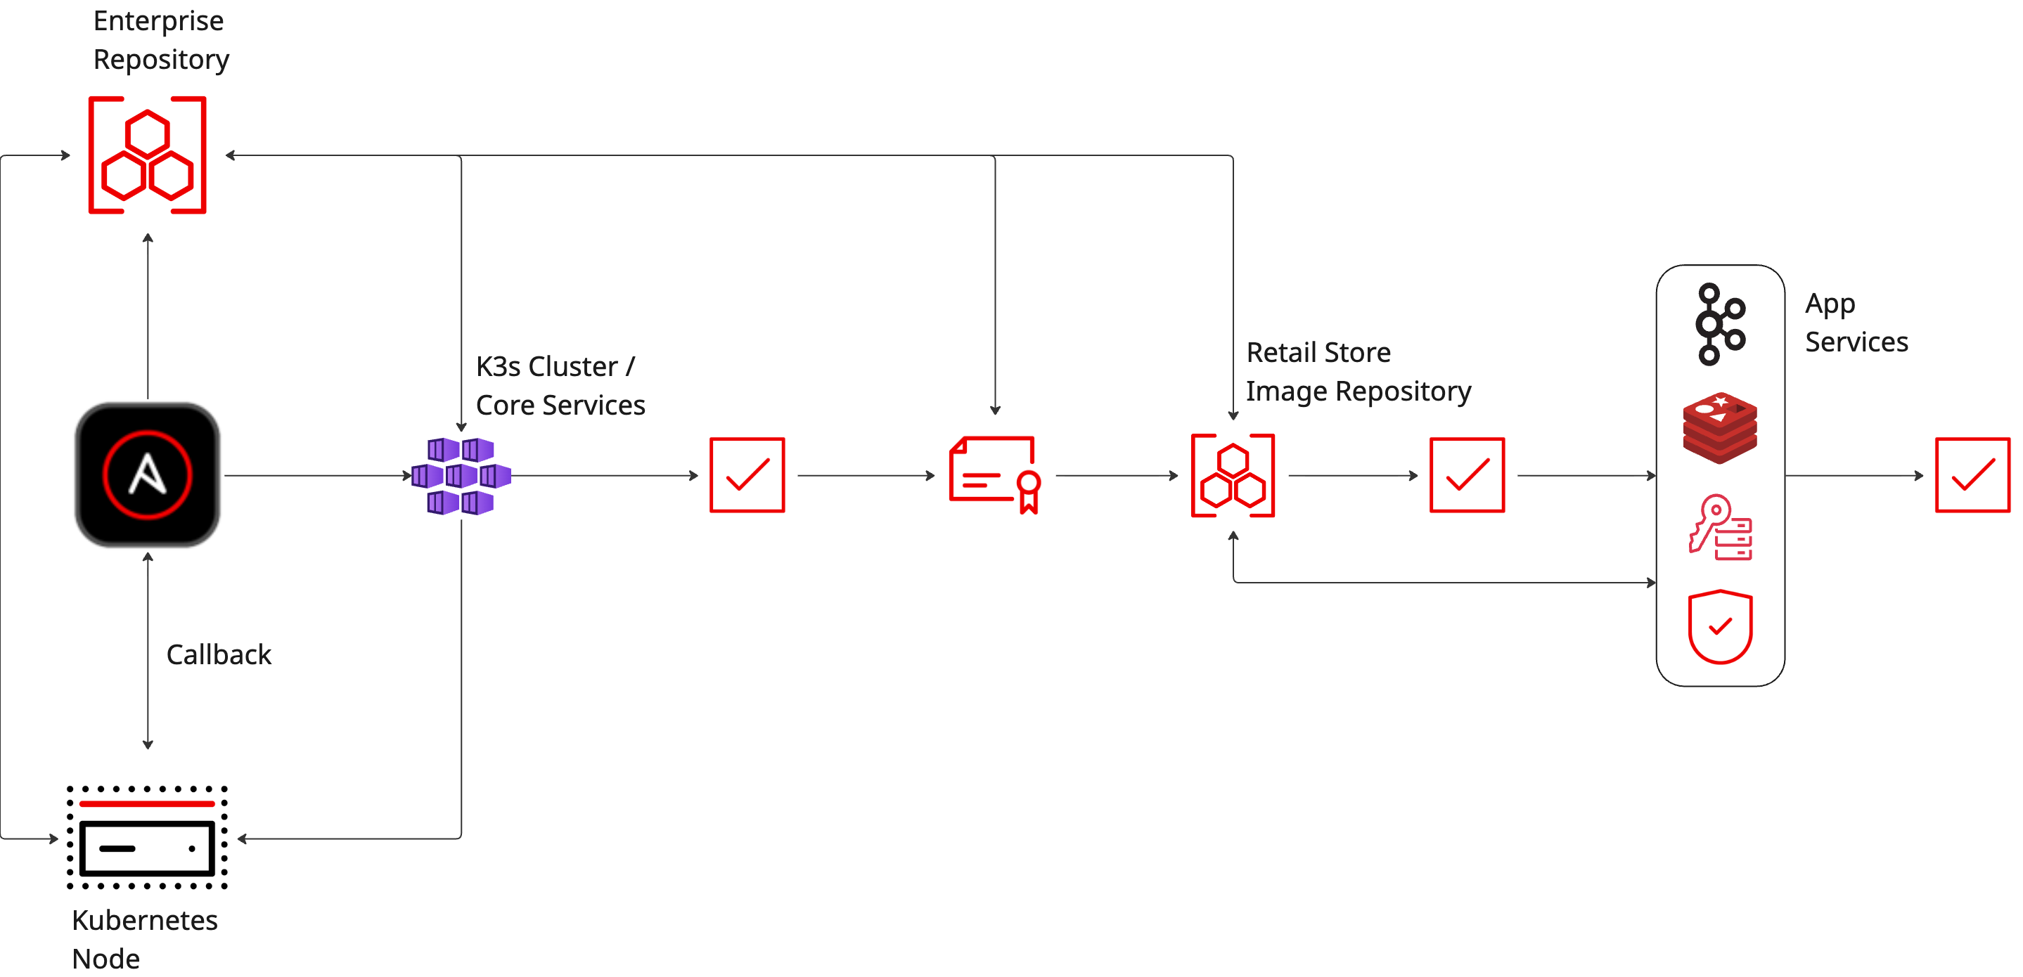
Kubernetes Cluster Orchestration
Notes:
Single node deployment, hardening and configuration using Ansible callbacks
K3s cluster deployment and core services orchestrated with Ansible workflows
Application services deployment to K3s orchestrated with Ansible workflows
Automated testing and validation throughout the workflow – outcomes back to DevOps for visibility and trending
Daily OS hardening – keeping the platform secure – preventing configuration drift
Daily cluster validation – ensuring stability for application services running in our stores
AAP has also enabled the Kubernetes engineering team the ability to seamlessly deploy two additional nodes to the stores and expand the cluster to improve platform resiliency for core services and application services that support HA
[Next]
Improved governance by incorporating GitOps around an everything as code model.
Using build pipelines to ensure all Ansible code is PR protected, validated, and scanned.

Slide 6
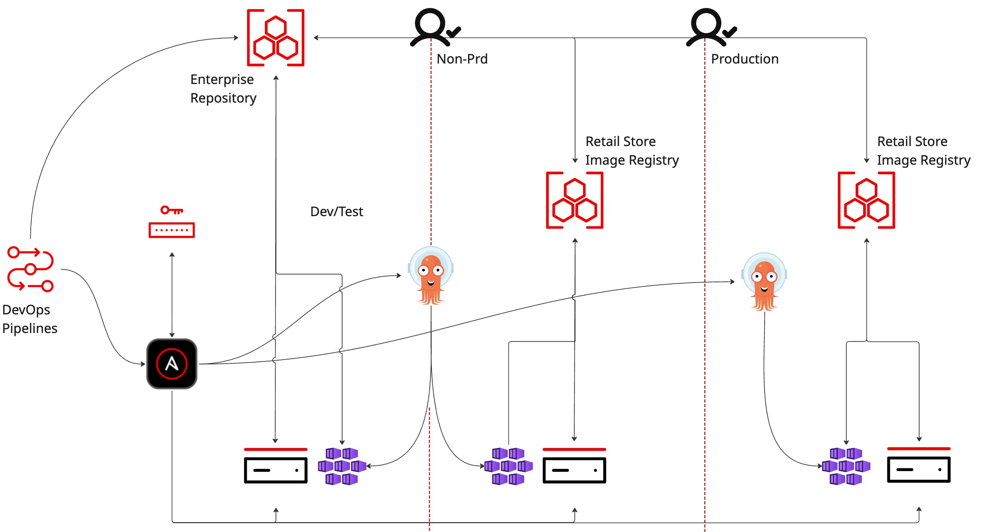
Continuous Software Delivery
Notes:
**Continuous? What does that mean?
Automatic deployments to development / testing environments
Software is deployed as soon as the PR is approved, the code is merged, and validated
Publix enabled this capability by integrating Ansible automation with pipelines triggers in devops based on certain criteria
This bleeding edge approach, provides an environment for the target audience to immediately evaluate new features and provide instant feedback to development teams
Self-service (continuous, but gated to ensure teams responsible for ensuring stability in Retail have reviewed and approved releases)
Gated self-service releases to certification environments for more rigorous testing
Gated self-service PRD releases to stores
(schedule related dependency checks, change management validation, and manager approvals)
The K8s team at Publix has done an incredible job standing up a stable feature rich platform for application teams to consume and release software and teams are taking advantage of these modern capabilities.
Devops pipelines, triggering Ansible automation integrated with ArgoCD to sync new releases to Kubernetes in the stores as well as validate that services are running and healthy
But what about windows? We now have an image registry in the stores, why not leverage that to distribute code to the stores just like we do for container workloads.
To bring the continuous release capabilities and alignment with cloud native releases, Publix delivers code targeting windows in OCI Artifacts.
Various app package types are added to non-runnable container images, tagged and published to our enterprise repository and mirrored to the store image registry. Ansible automation platform job templates and workflows take over from there by retrieving the OCI Artifact, unpacking it, and then orchestrating the installation and validation of the release.
This mechanism simplifies the release process for Publix application teams targeting multiple platforms by aligning the artifact and release mechanism used for deployments.

Slide 7
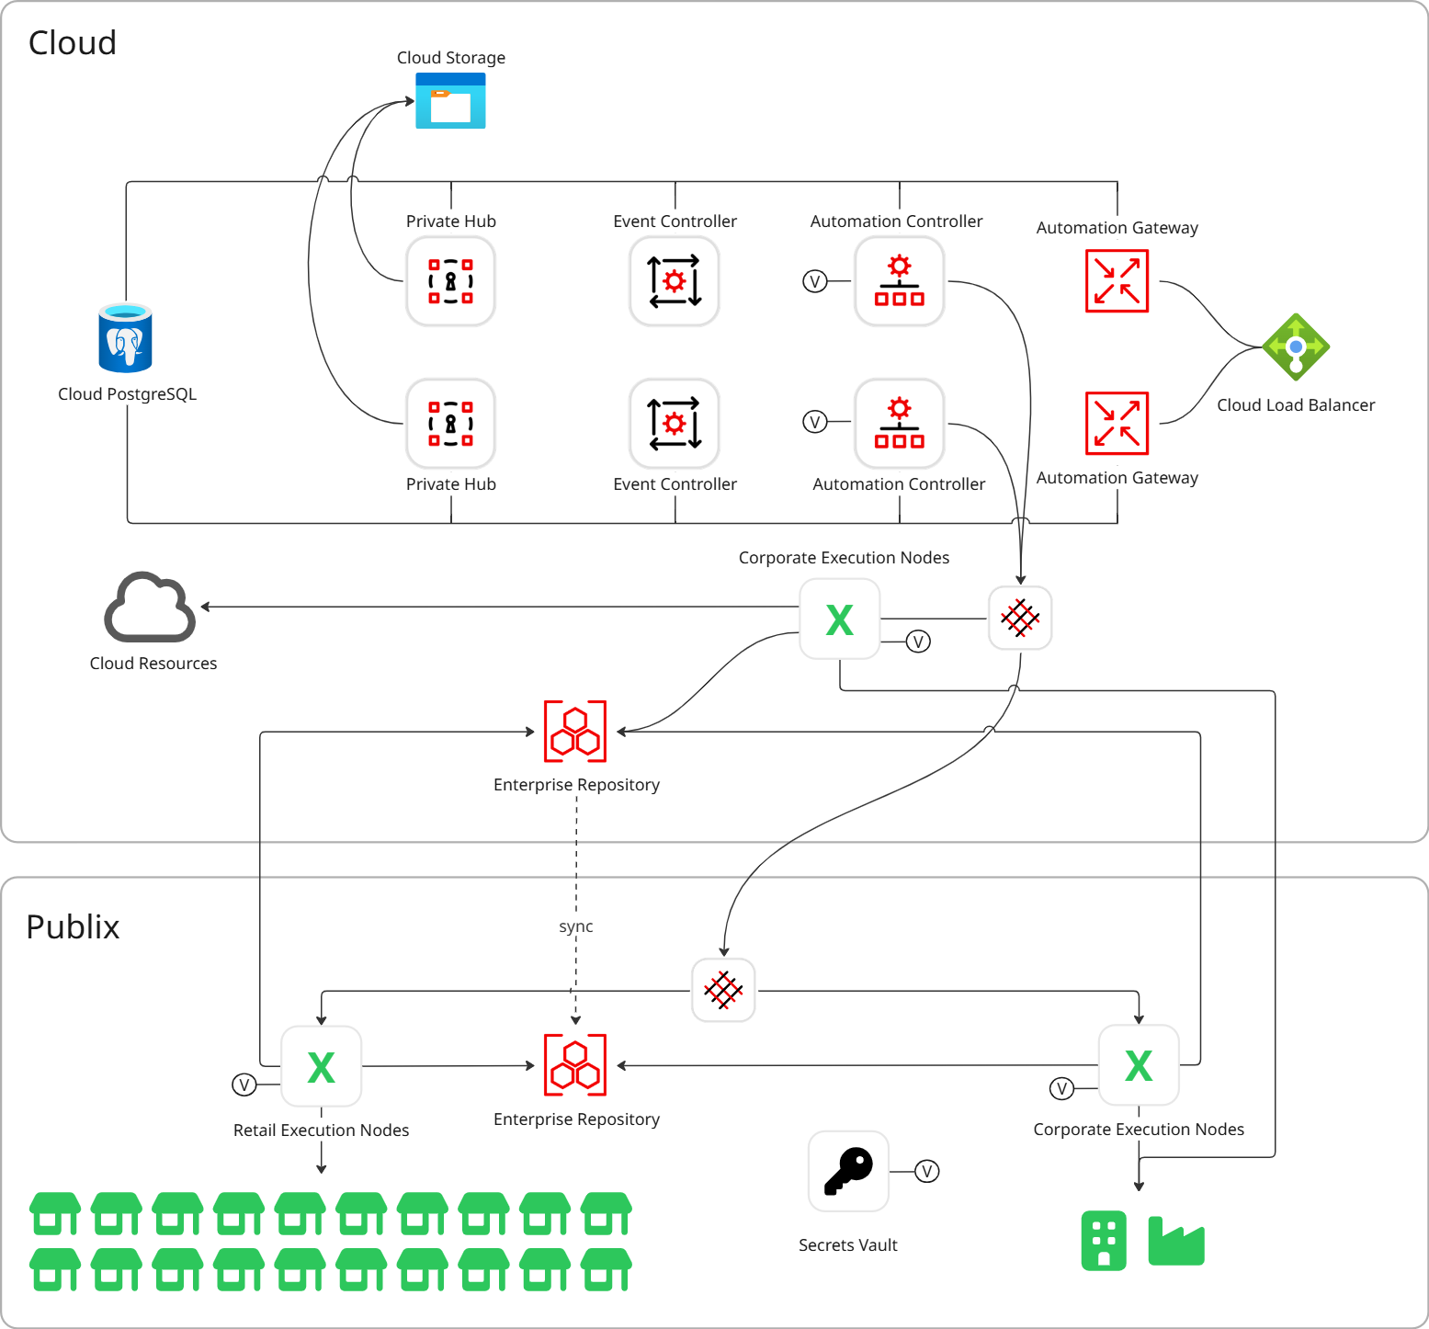
Ansible
Landscape

Slide 8



Future
AI
User/Team adoption
Event Driven
Notes:
*ccaas
*event driven automation
*self-healing

Slide 9
Notes:
Publix Technology is fortunate to have highly technical and supportive leadership that encourages innovation. With the introduction of agentic development coupled with flexible modern platforms like AAP, Publix Technology is flourishing with ideation, creating an ecosystem of enablement with endless possibilities. It is a very exciting time to be in tech, especially at Publix with partners like Red Hat.

